Slide 1
SiO2 Thickness Measurement Program
By willow Valeria Pichardo

Slide 2
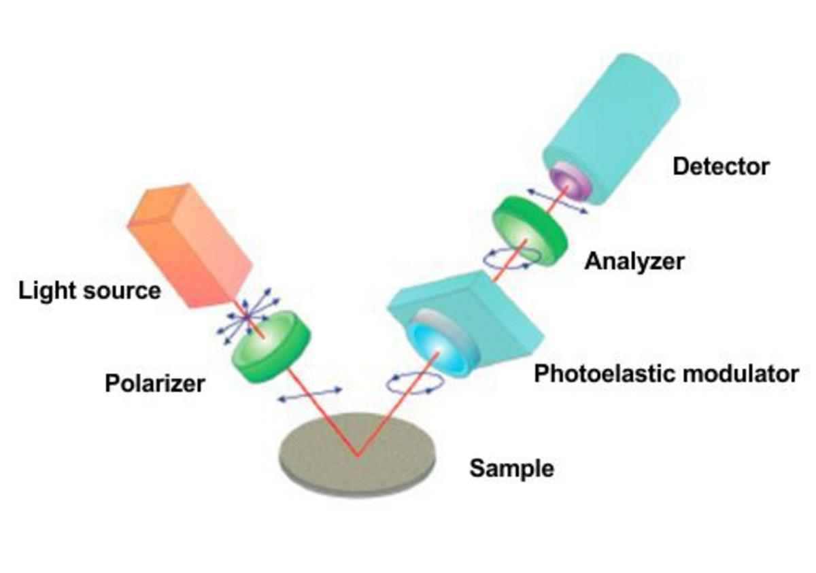
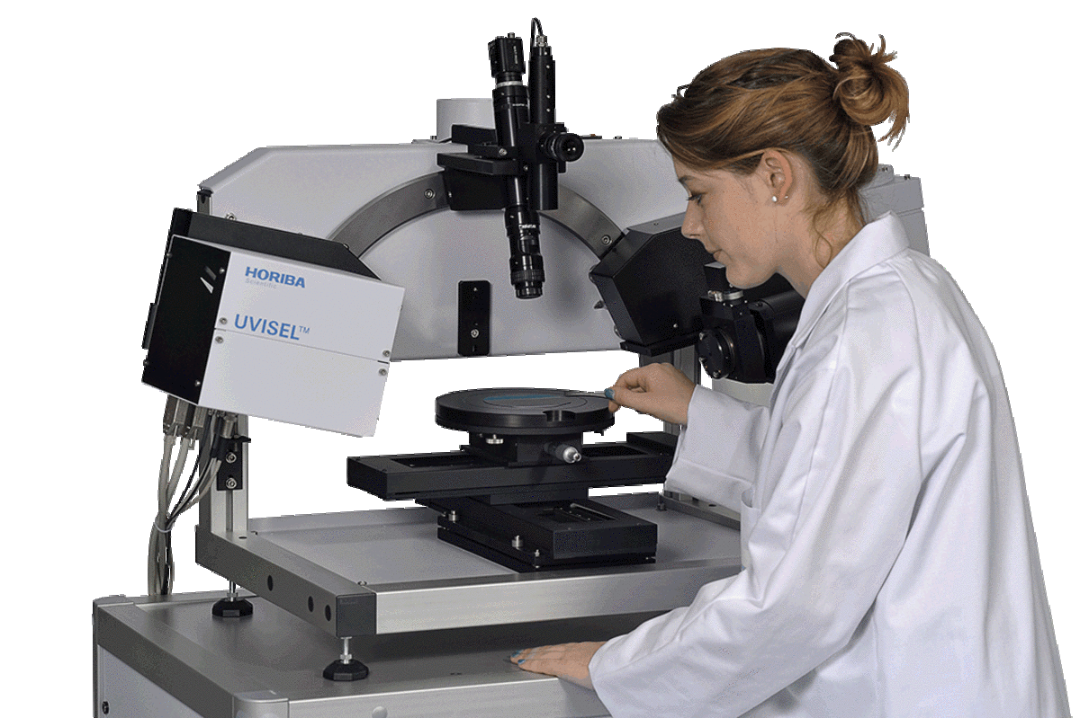
Motivation
Currently unable to determine thickness quickly, with (relatively) inexpensive equipment
Knowledge crucial to producing desirable characteristics and repeatable results
Current measurement takes a long time, utilizes expensive equipment, and is highly complex

Slide 3
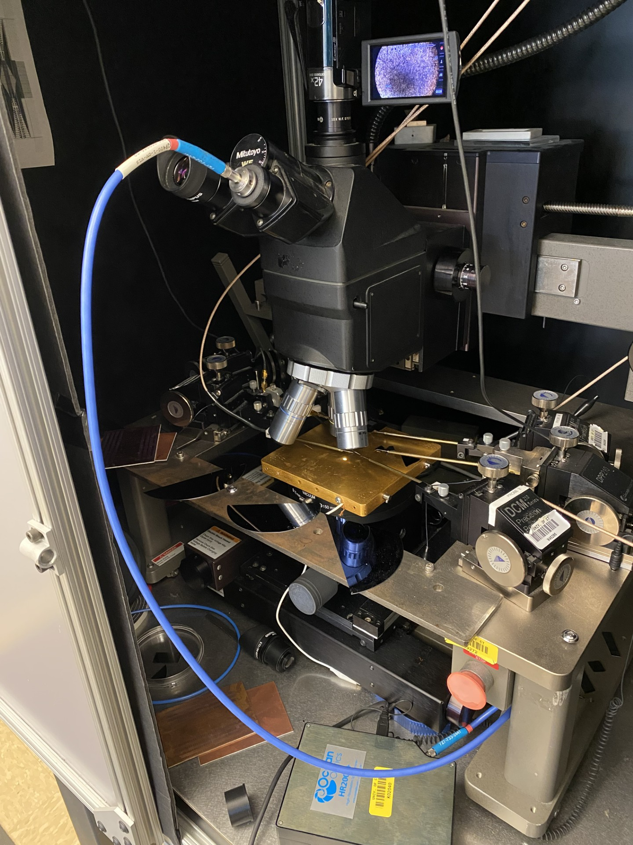
Spectrometer
Optic Coupler inserted into microscope eyepiece tube
Ocean Optics HR2000+
Returns Intensity vs Wavelength in graphic and csv form
Attached to microscope utilizing 3D printed mounting piece, courtesy of Gordon Levasseur
Is very quickly set up (a few minutes), relatively cheap ($5,000 vs $50,000+), easy to train and use
Ocean Optics HR2000+

Slide 4
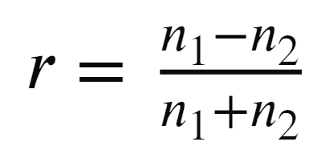
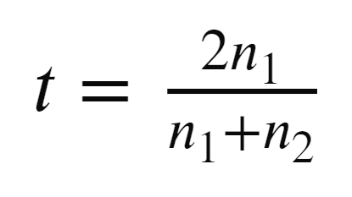
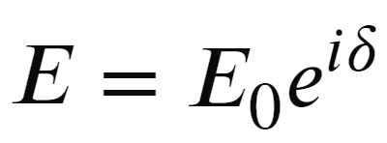
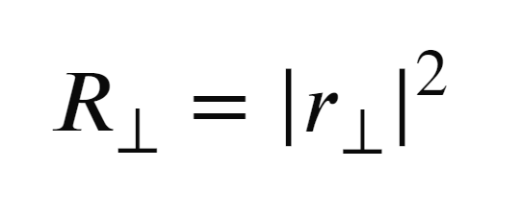
Model
Amplitude Reflection Coefficient @ Normal Incidence.
Utilizes Fresnel equations to extract reflectance: R(λ)
Assumes singular, thin film, on top of a “semi-infinite” wafer
This model can possibly work with more layers
Assumes normal incidence of light to simplify Fresnel calculations
Experimentally enforced by microscope
Four
Principle
Equations
Amplitude Transmission Coefficient @ Normal Incidence.
Phase accumulation when inside a medium
Fresnel Power Reflectance

Slide 5
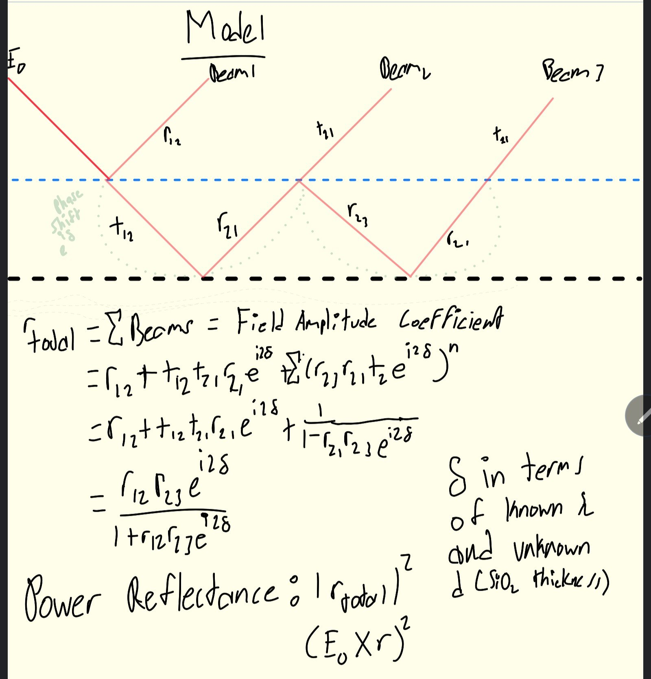

Slide 6
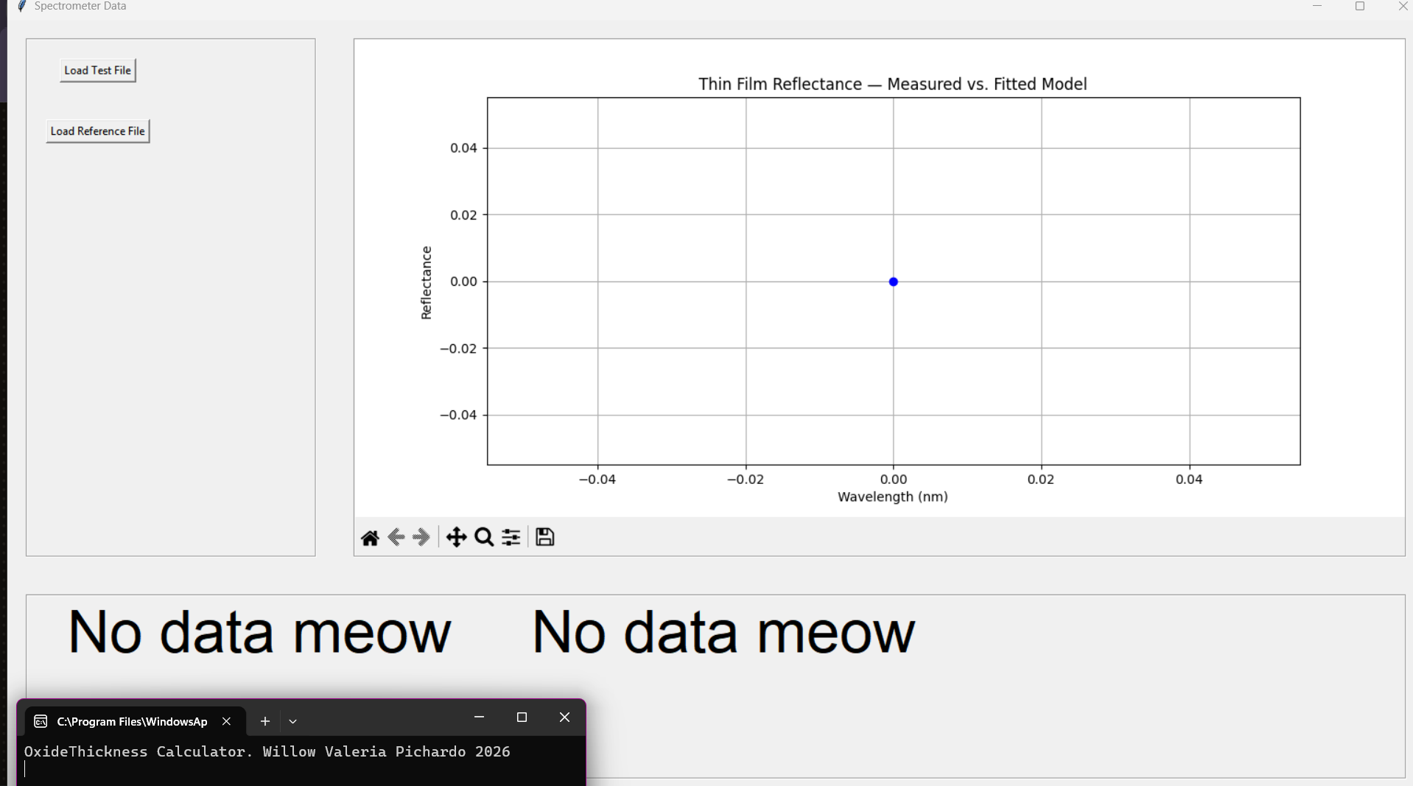
Program
Intakes a reference file and sample file
Subtracts the experimental data from the model equation, and optimizes for least square minimum error
Outputs graph of measured reflectance data and overlayed model of best fit
Displays thickness and RMSE error

Slide 7
Program
Intakes a reference file and sample file
Subtracts the experimental data from the model equation, and optimizes for least square minimum error
Outputs graph of measured reflectance data and overlayed model of best fit
Displays thickness and RMSE error

Slide 8
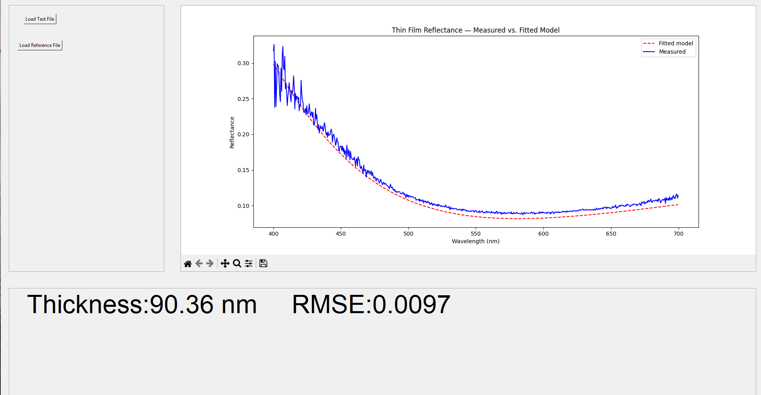
Results
Minimal error when utilizing consistent lab practices
Subtract “dark” noise by using 45º silicon wafer to acquire dark measurement and subtracting from collected data
Use multiple samples and average, or increase integration time
Ensure not to saturate the sensitive spectrometer
Best results with measured 90.36nm wafer and .0097 rmse @ 100ms int

Slide 9
Results
Minimal error when utilizing consistent lab practices
Subtract “dark” noise by using 45º silicon wafer to acquire dark measurement and subtracting from collected data
Use multiple samples and average, or increase integration time
Ensure not to saturate the sensitive spectrometer
Best results with measured 90.36nm wafer and .0097 rmse @ 100ms int
Error: .0097/90.36 = .0107% error!

Slide 10
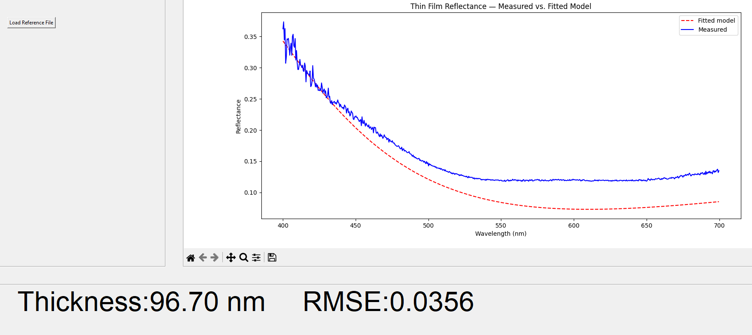
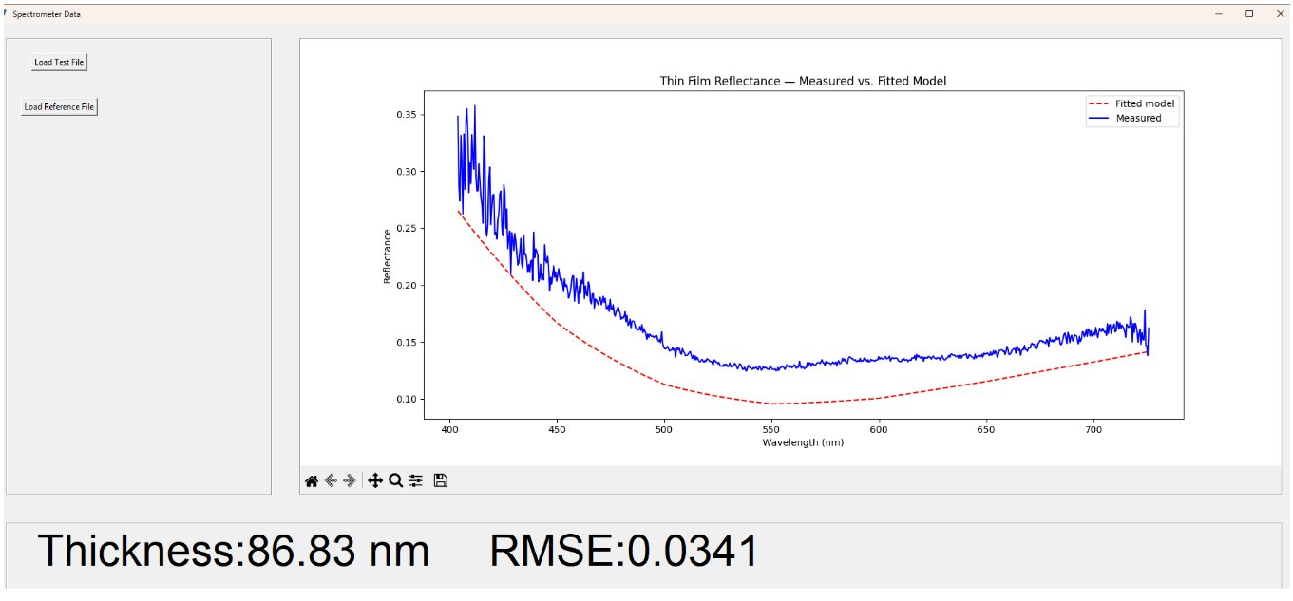
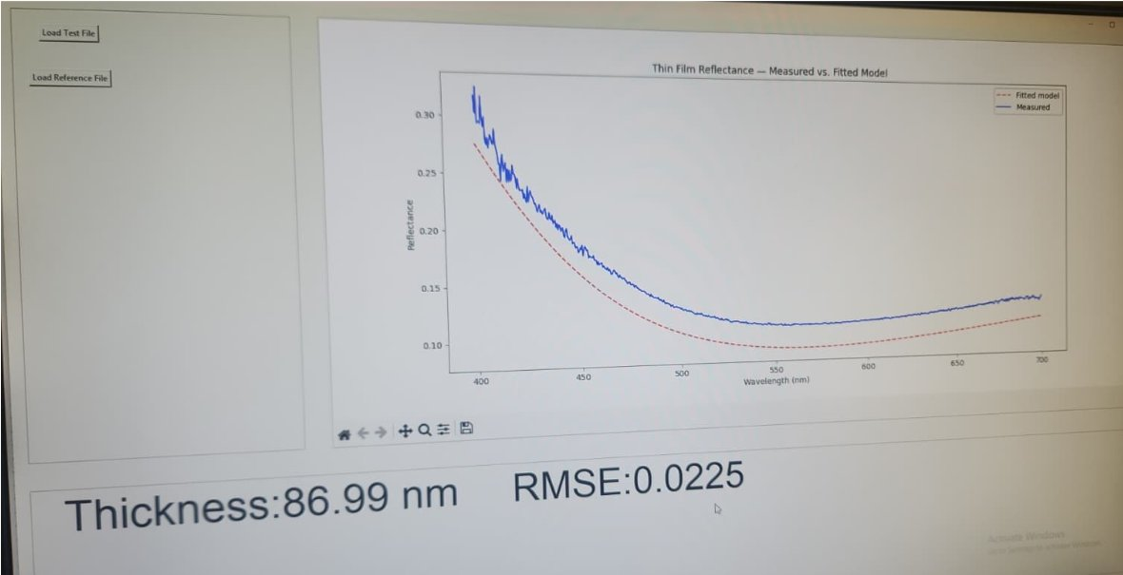
Same graph as prior but without dark measurement. High vertical offset, 6.34 nm difference, .0259 increase in RMSE
Wafer measured at 100ms int, no dark measurement, no sample averaging
Same wafer as left, with averaging

Slide 11
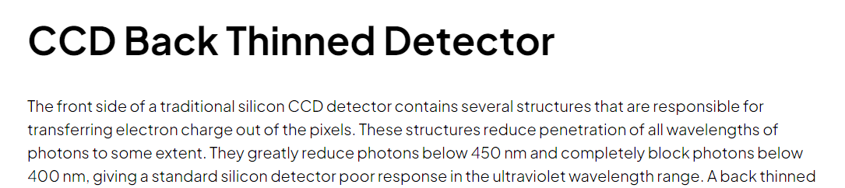
Message on Ocean Optics Website
This could address the poor data <450nm. Averaging helps resolve this issue, but truncating is often recommended.

Slide 12
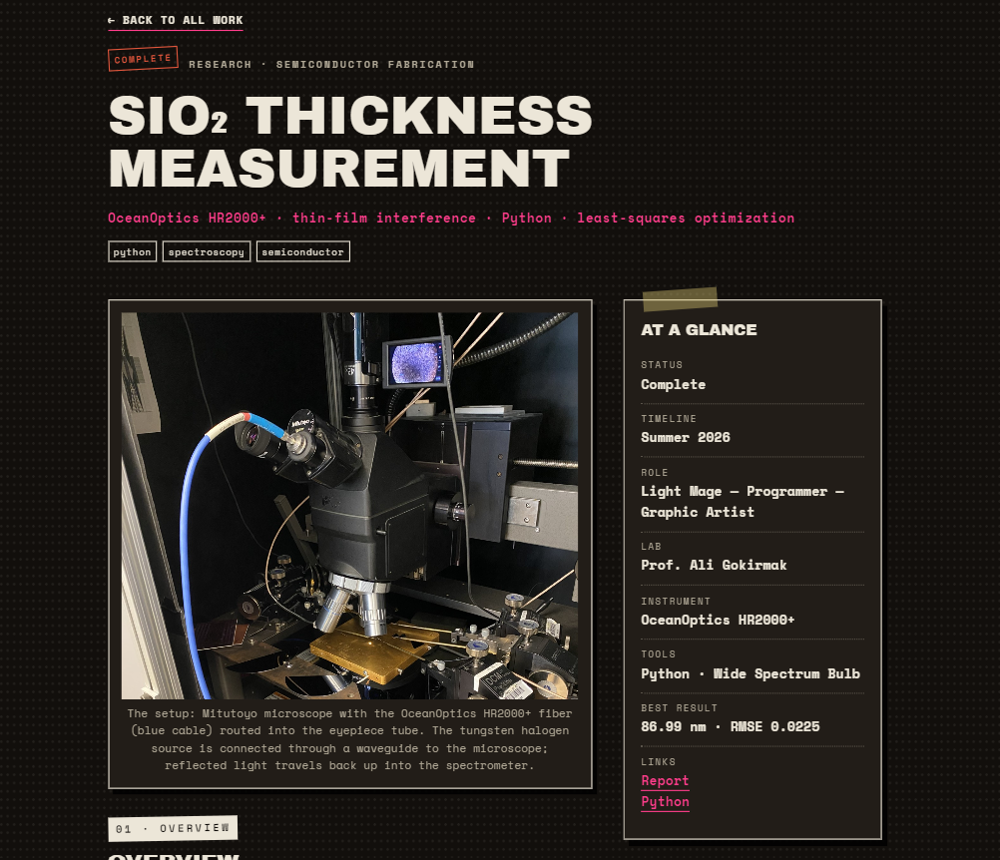
Future
Spectrometry is heavily accessible to undergraduates utilizing this device
Quick training and data turnaround
Database of other wafers and their reflective indices
Drop down menu to select structure of the wafer
Housed in a more dedicated setup
As to not occupy one of the central microscopes of the lab
Compare to ellipsometer data to determine true accuracy
Check out the report on my website: willowpichardo.com

